Slide 1
IBM Data Science Capstone
Recommending Location for an Indian Restaurant in Chicago Using Data Science
By Vishnu Vardhan Reddy
January 30, 2021

Slide 2
Business Problem
Chicago is one of the biggest cities in the U.S.A with considerable cultural diversity, income level disparity and demographics.
Chicago already has a big restaurant industry with over 7,300 restaurants catering to growing base of food lovers.
With Ivy league and reputed educational institutions set up in the Illinois and Chicago area, such as University of Illinois, University of Chicago etc., many international students, particularly from India are expected to be part of the student community.
How do we find the best location to open an Indian restaurant leveraging data analytics and machine learning techniques?

Slide 3
Data
Required Data:
List of Chicago neighborhoods
Geocoding of the neighborhoods
Using Foursquare API – getting venue information for each neighborhood
The data collected for this project includes:
Community area and per capita income (including hardship index)
Census data by community area to understand the demographics
Most recent crime data (prior twelve-month period) along with description and coordinate information
Active business licenses and location information

Slide 4
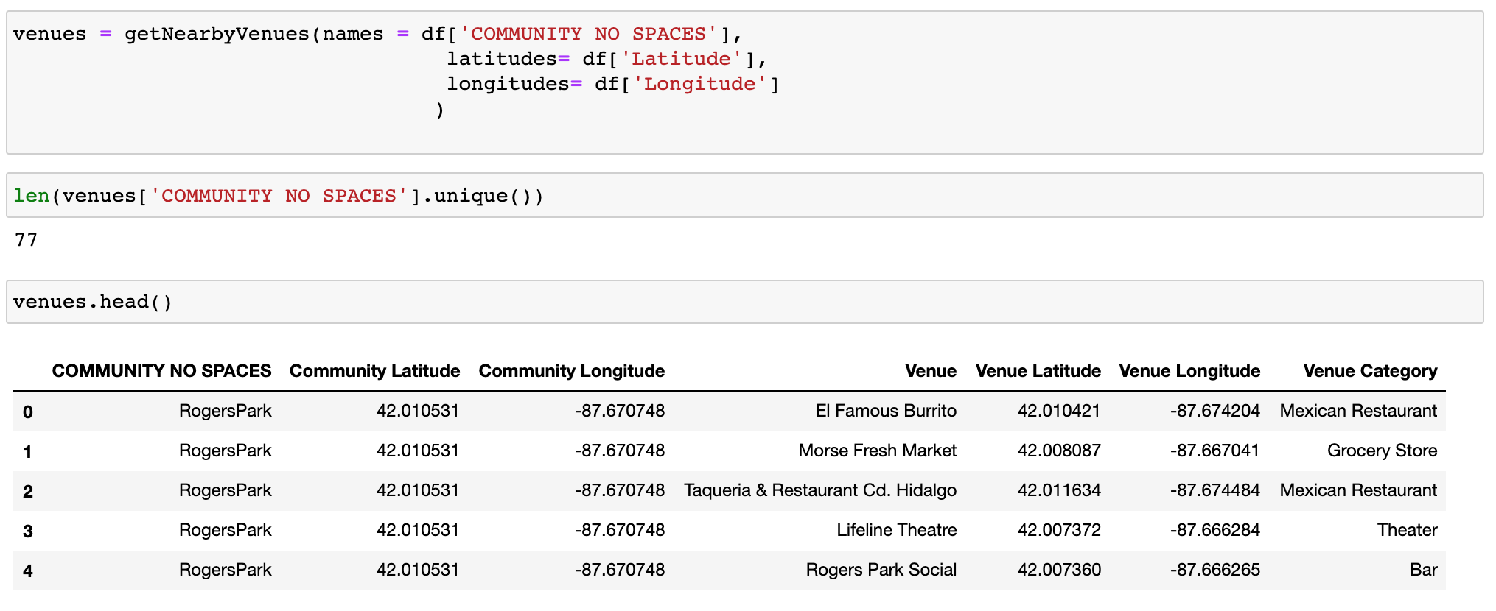
Foursquare API
Using the Foursquare API, corresponding venue names with category and location info is pulled and stored into a dataframe

Slide 5
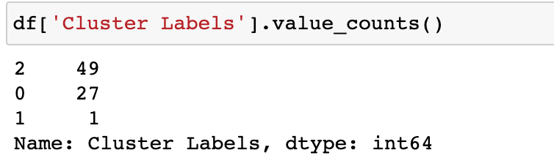
Methodology
One-hot Method:
Once the nearby venue information is gathered, we then analyze communities by creating a dataframe with “zero” or “one” value for each venue category for a corresponding community.
We then group the communities and find the mean score for each venue category.
K-Means Clustering:
Now, we train the data with the K-means clustering algorithm and find clustered communities.
Number of clusters chosen were 3 for this analysis which yielded better classification.

Slide 6
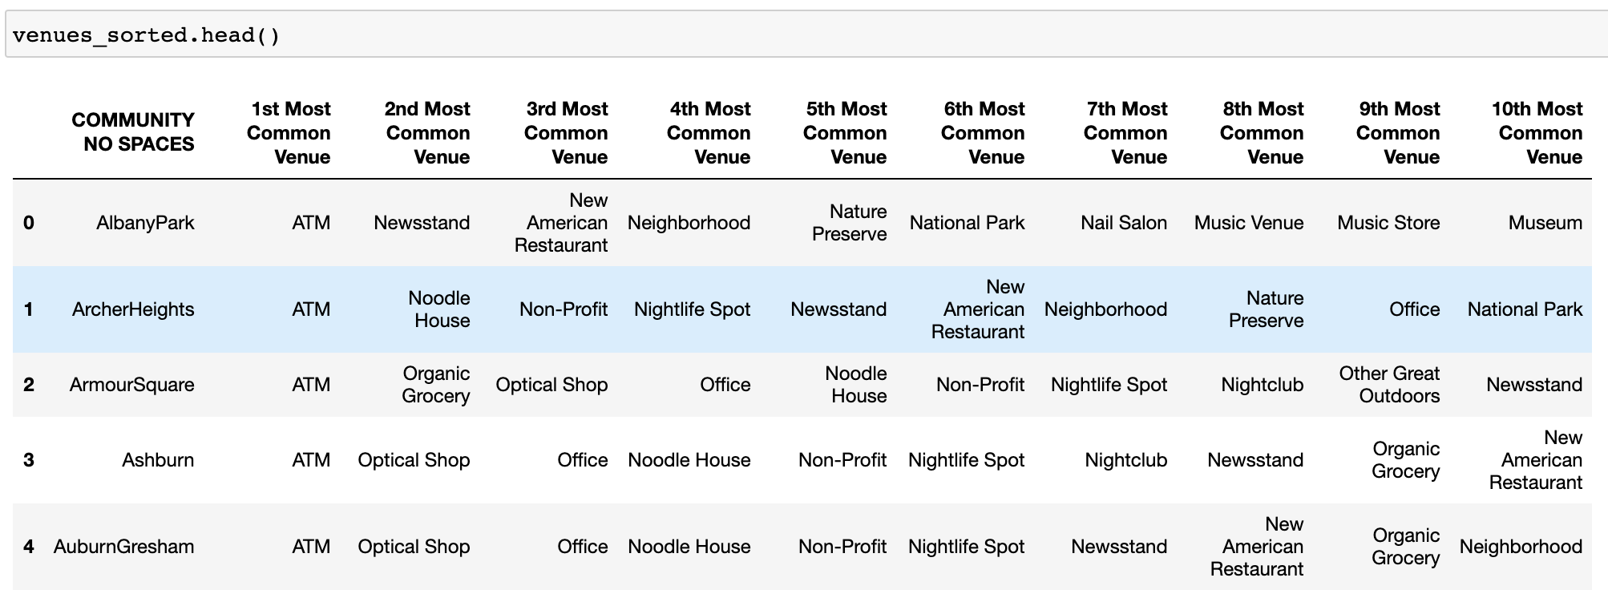
Top 10 Most Common Venues

Slide 7
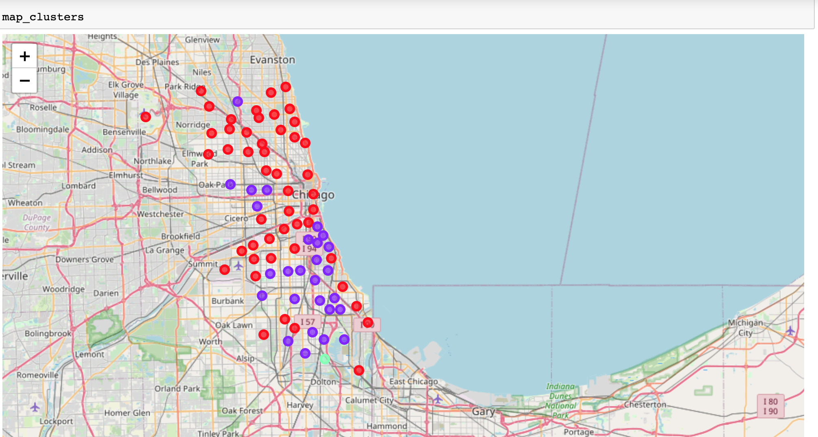
K-Means Clustering

Slide 8
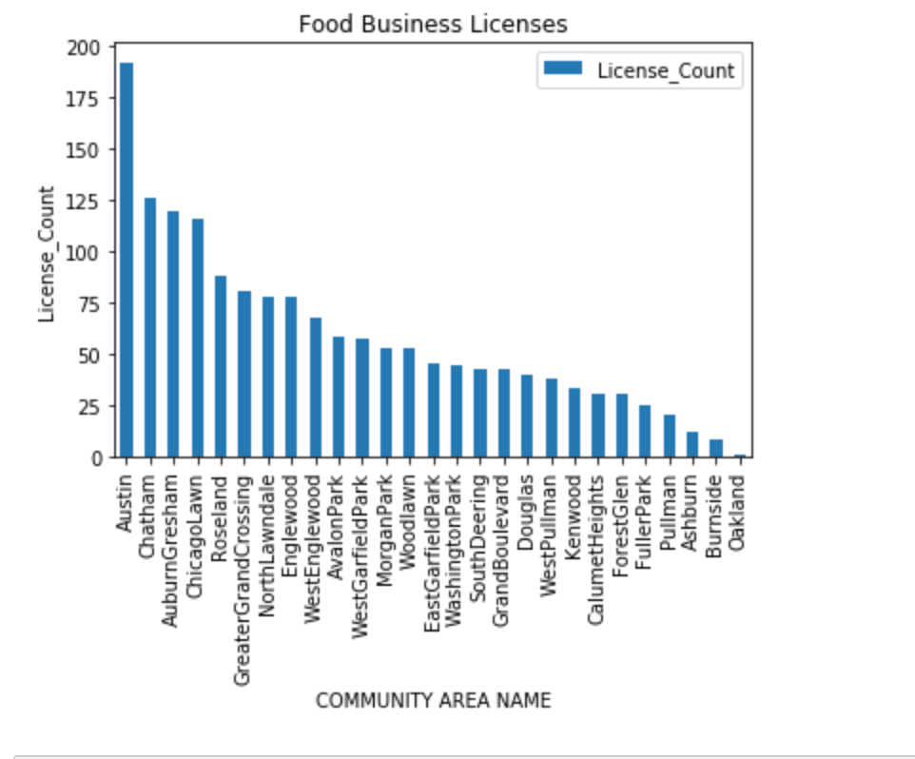
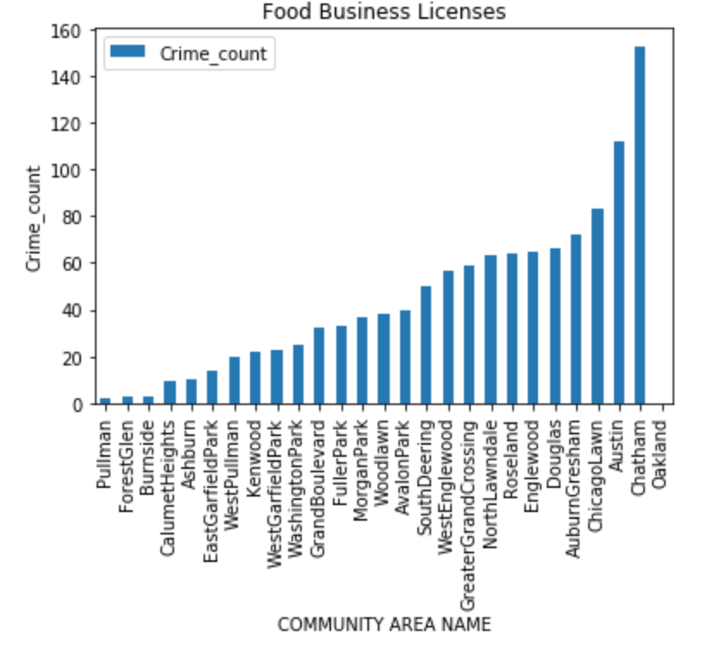
Visualization
Community Area vs License Count
Community Area vs Crime Count

Slide 9
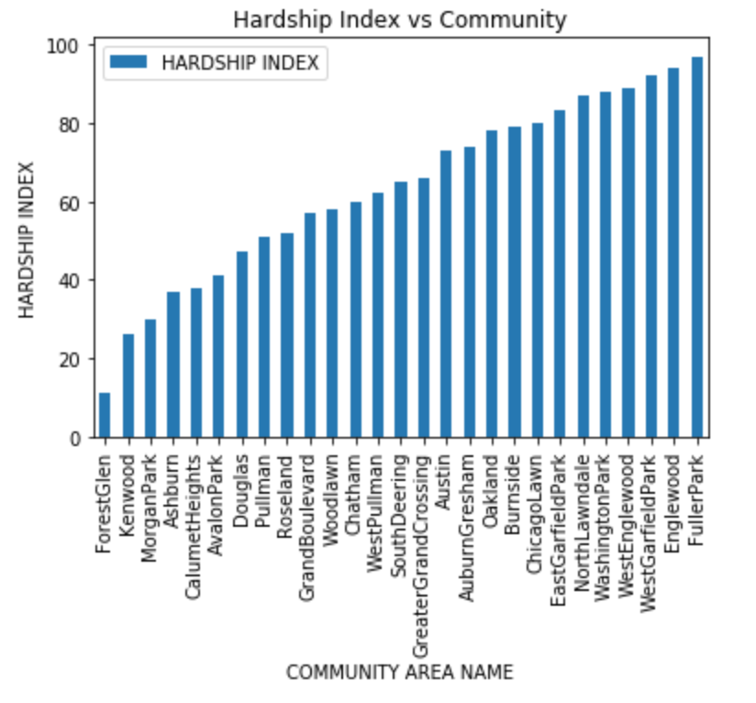
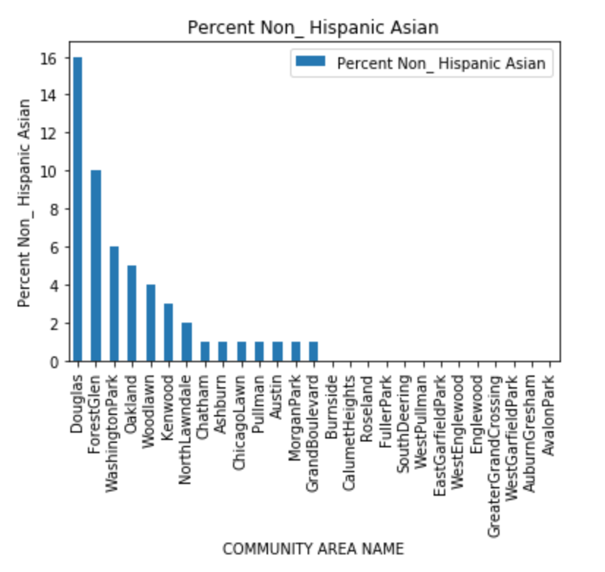
Visualization- Cont.
Community Area vs Hardship Index
Community Area vs Non-Hispanic Asian

Slide 10
Results
Now, we identify the best communities with
High business licenses (high business activity attracts higher workforce and customers for food business)
Low crime count (safer community with lower insurance costs)
Low hardship index (people have higher spending power)
High Asian population (better chances of attracting people with similar food tastes and preferences)

Slide 11
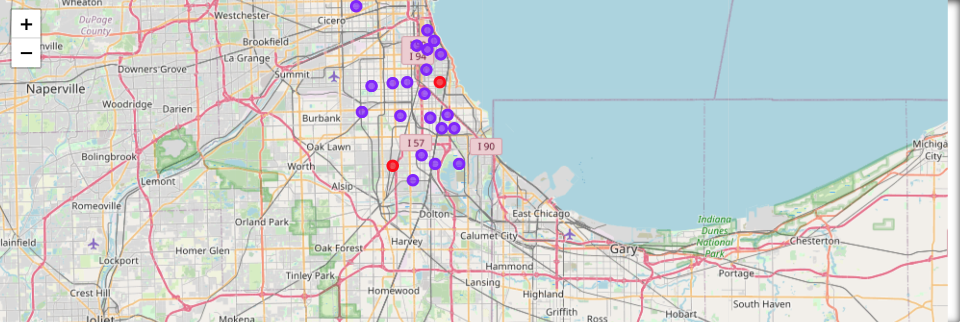
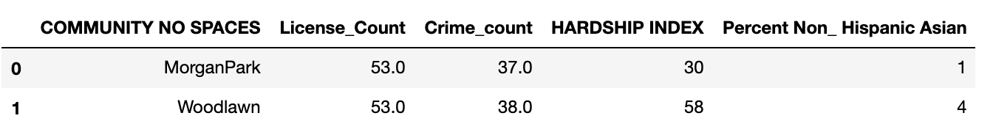
Results – Best Two Communities

Slide 12
Discussion & Recommendation
Based on the analysis, it is beneficial to open a new Indian restaurant in either Morgan Park or Woodland communities.
If we analyze these two communities, we note that these two communities are similarly positioned in the number of active businesses and crime counts in the areas.
However, the hardship index is better in Morgan Park compared to the Woodlawn community and non-Asian population is higher in Woodlawn community.
We can offer the client/ end customer with both options and decide a community based on the scale of the restaurant.
If the client wants to set up a high scale restaurant, Morgan Park is the recommended community. If the plan is to set up a low/mid-scale restaurant, Woodlawn community is a better one.

Slide 13
Conclusion
In this project, we have been able to understand the needs of the end customer and offer recommendations/ solutions using machine learning and proper data analysis techniques.
This can be an iterative process with feedback and inputs for improvisation. There may arise a need to increase the cluster count or machine learning techniques depending on additional data.

Slide 14
References
https://data.cityofchicago.org/Health-Human-Services/Census-Data-Selected-socioeconomic-indicators-in-C/kn9c-c2s2
http://www.actforchildren.org/wp-content/uploads/2018/01/Census-Data-by-Chicago-Community-Area-2017.pdf
https://data.cityofchicago.org/Public-Safety/Crimes-One-year-prior-to-present/x2n5-8w5q
https://data.cityofchicago.org/Community-Economic-Development/Business-Licenses-Current-Active/uupf-x98q
https://www.chicago.gov/city/en/about/facts.html

Slide 15
THANK YOU

